Slide 1
Understanding the public education system
Presented by Adie Simmons
Office of the Education Ombudsman
1-866-297-2597 www.waparentslearn.org
Notes:
Speak of transition from opening discussion to these core beliefs – beliefs that must underlie all the rest of the presentation.

Slide 2
The Washington State Constitution
“It is the paramount duty of the state to make ample provision for the education of all
children residing within its borders, without distinction or preference on account of race, color, caste or sex.” (Article IX, Section 1)

Slide 3
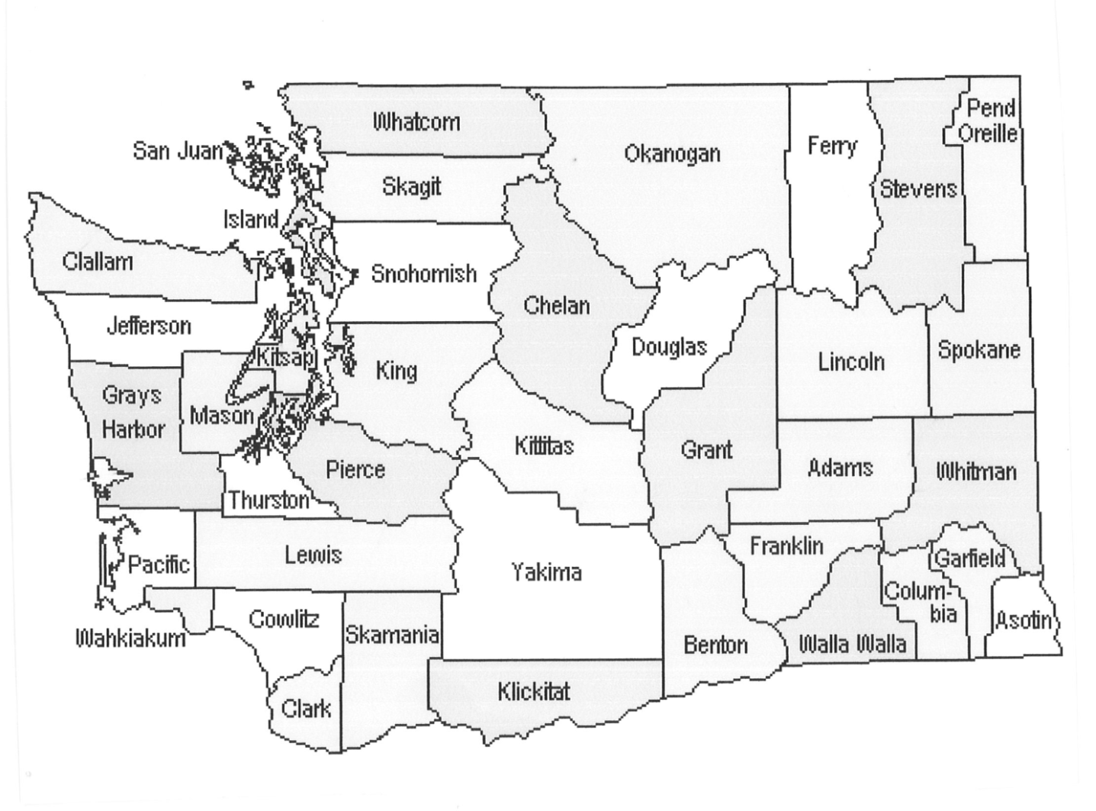
The big picture - Washington State
There are 295 school districts in WA
There are 2,278 school buildings in WA
1,027,312
students are enrolled in K-12 public schools
75% of all students attend
Western WA schools

Slide 4
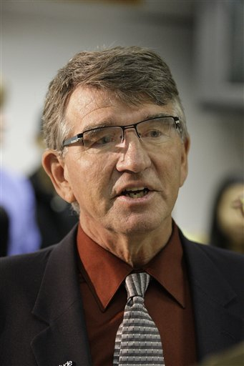
Who is in charge of Public Education in Washington State?
The State Superintendent of Public Instruction
Elected by voters every 4 years.
Manages the Office of the Superintendent of Public Instruction
Oversees the distributions of funds for each school district
Ensures that school districts are meeting their obligations
Helps pass state education laws
Website www.k12.wa.us
Notes:
10 minutes for slides 12 and 13.

Slide 5
The State Board of Education
The Washington State Board of Education is responsible for strategic oversight of the public K-12 system.
The Board is formed by 16 voluntary members (including Governor-appointed citizens, school-board elected members, the Superintendent of Public Instruction, and two student representatives),
They meet regularly to explore policy implications for our schools, to advocate for best practices, to engage the public in discourse about our education system.
Website http://www.sbe.wa.gov

Slide 6
School Districts
There are 295 School Districts in Washington.
Each one is independently managed by a School Board and a Superintendent.
The largest one is Seattle with almost 47,000 students enrolled.
There are very small rural school districts around the state.

Slide 7
What is local control?
Every school district operates independently.
The Superintendent of public instruction does not manage all school districts, all Superintendents or dictates what they should do.
School Board members choose to adopt their own policies and procedures.

Slide 8
Voters
Play a critical role in public education
Public Education = Democratic system

Slide 9
All school districts are organized in the same way
VOTERS
School Board
Superintendent
Principal
Teachers/School Staff
Notes:
Transition discussion – this is a new topic that will establish the structures of the school system. While structure can appear solid, we will discuss how issues fit into the structure and where access and challenges to entry exist.
School board = elected by voters to set goals, conduct strategic planning, hire and oversee the superintendent, adopt the school district budget and create policy.
Superintendent = hired by the school board to manage the school district.
Principal = reports to the superintendent. Manages staff and student body and day to day operations of the board.
Teachers = report to principal.
5 minutes for slides 9, 10, and 11.

Slide 10
How are school districts funded?
District funds come from a variety of sources:
From local property taxes
From the state
From federal funds for special programs such as Special education, Title I, Migrant, Bilingual, etc.
From local property taxes (levies).
From private funds (grants)
Notes:
Money comes from a variety of sources, making district finance complicated.
Money can usually only be spent for designated purposes.
School board approves where the superintendent and staff will spend district money.
Understanding school district spending can give you insight into what happens in your school district, which will help you make well informed suggestions to your school board representatives.

Slide 11
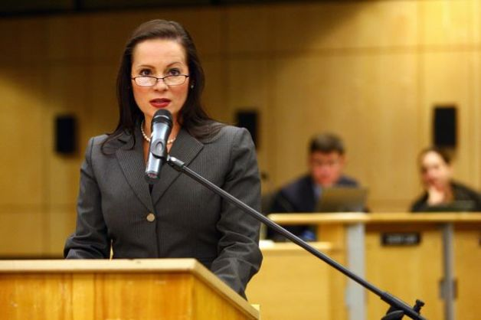
School District Superintendent
He or she is hired and supervised by the school board
Manages everyday operations and staff
Develops district budget for Board approval
Oversees academic programs
Carries out district policy
Has authority given by school board
Notes:
Hired and evaluated by the school board. Hires and oversees principals, develops the annual budget for school board approval and oversees staff and academic programs.
Issue – appeals of enrollment, discipline issues, complaints about a teacher or administrator.
Access- District committees charged with setting district vision and goals, review of policies/procedures.

Slide 12
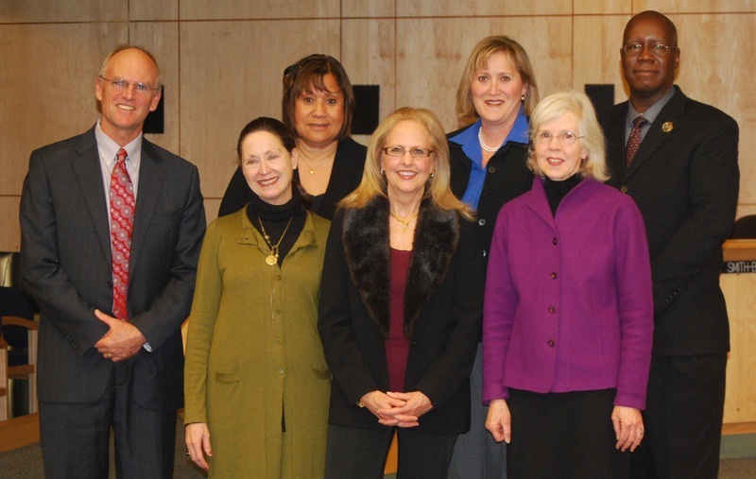
What is the School Board?
A group of elected citizens that:
Create a vision and set goals for the school district
Develop a strategic plan
Hire and oversee the Superintendent
Adopt policies and procedures for the school district
Approve budget and education plans
Represent voters
Make decisions that impact all students
Notes:
Issue – school district policy/procedure. Access – contact Administration office, explain the question, and ask for the appropriate referral.
Access – public portion of School Board meeting.
5 minutes for Slides 16, 17 and 18.

Slide 13
School Board
There are 5 members per School Board except in Seattle, which has 7
Elections take place every other year in odd numbered years
Board members are volunteers, some get a small stipend
They are elected from specific neighborhoods but represent the interests of all students in the district
In some districts Board members serve 2-year terms in others 4-year terms
Notes:
School board members are also called directors.
5 per board except Seattle, which has 7.
Elections are every other year- in odd numbered years.
Not all positions are open every election.
Reimbursement may be a small fee, others only reimbursed for expenses
May be elected at large or from specific neighborhoods but task is to represent the interest of students in the whole district.
Serve four year terms (except in Spokane, Tacoma, and Everett, where terms are six years.)

Slide 14
Who can run for a school board position?
Any citizen who is a registered voter can run for a school board position in the school district where they live

Slide 15
How you can make a difference Citizen Participation at School Board Meetings
School board meetings must be open to the public
Agendas must be made public at least 24 hours in advance. Usually at the district website
Citizens must sign up in advance to speak at a School Board meeting
Meetings are broadcasts on public TV in some cities
School board members must post their contact information on the district website
Notes:
Family involvement takes many forms and contributes to student success. Participating in the school board process is helpful to your child, and has a positive impact on the larger community as well.
Agenda- made public at least 24 hours in advance. Often posted on the school board website.
Regular school board meetings usually include time for public comment. Many boards provide a sign up sheet near the entrance.
Meetings may be on cable TV or there may be an email list for individuals interested in school board news.
Share your opinions through letter or phone.

Slide 16
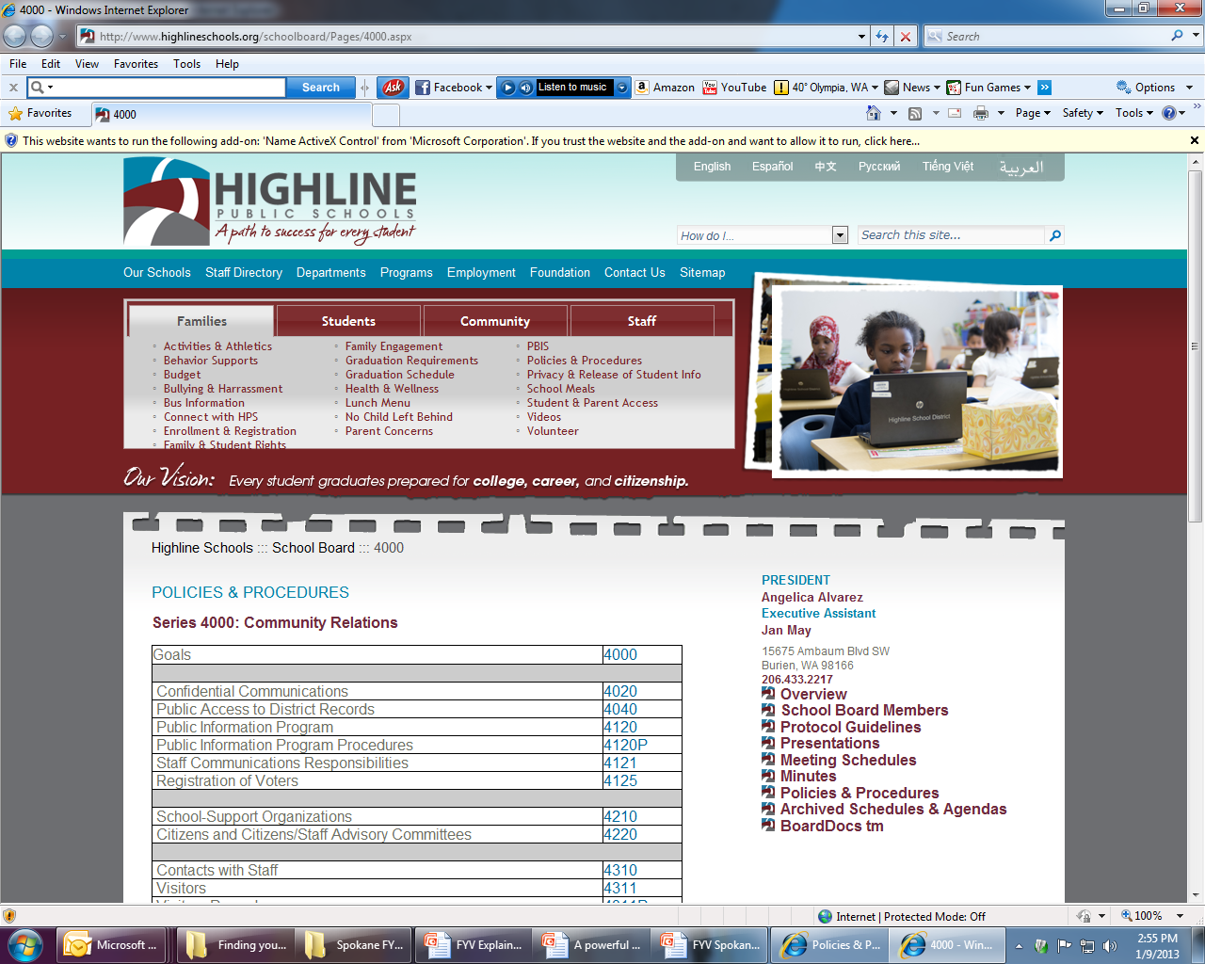
School District Policies and Procedures
School boards develop and adopt policies and procedures for their school district.
A policy is a rule or a regulation that everyone in the school district must follow.
Policies may not have procedures.
District policies are public documents and can be viewed by anyone.
You can speak to the school board if you believe that a policy needs to be changed or a new one created.
WASHINGTON STATE OFFICE OF THE EDUCATION OMBUDSMAN

Slide 19
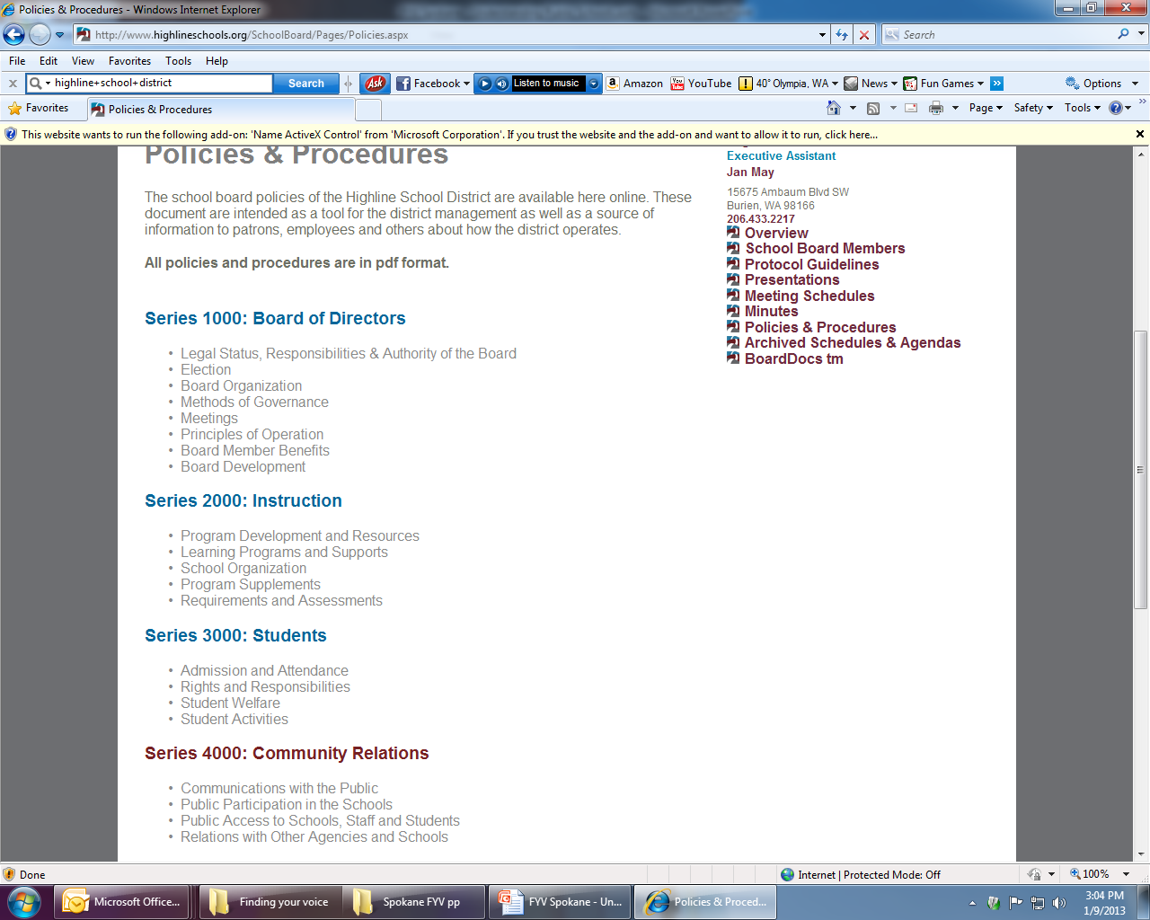
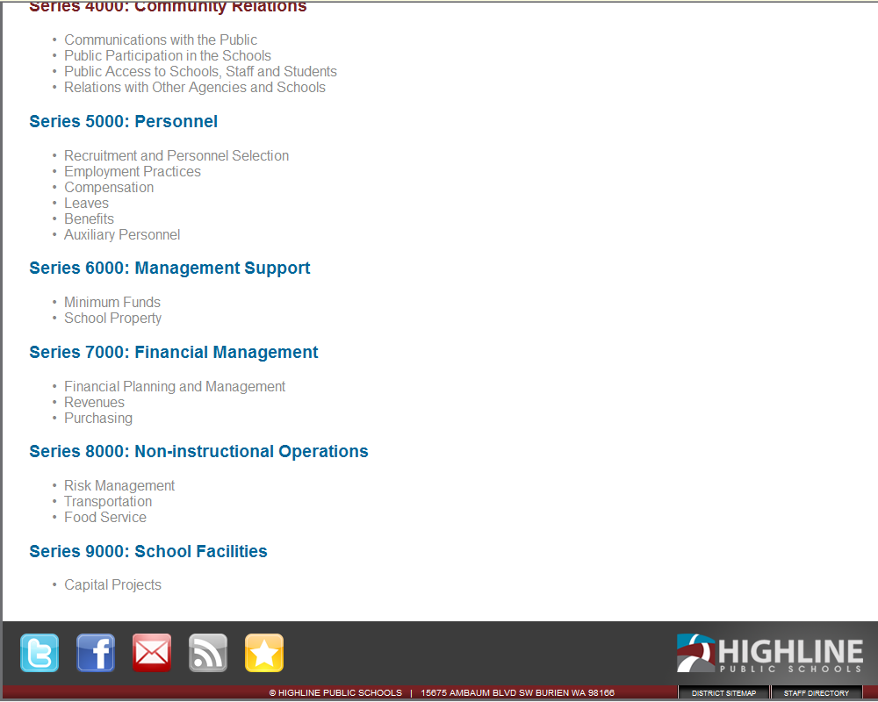

Slide 20
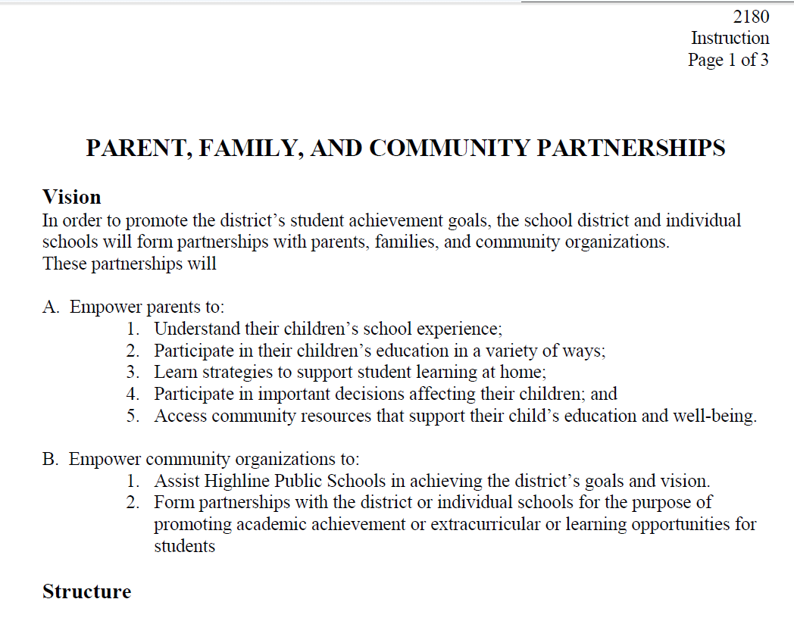
Highline

Slide 22
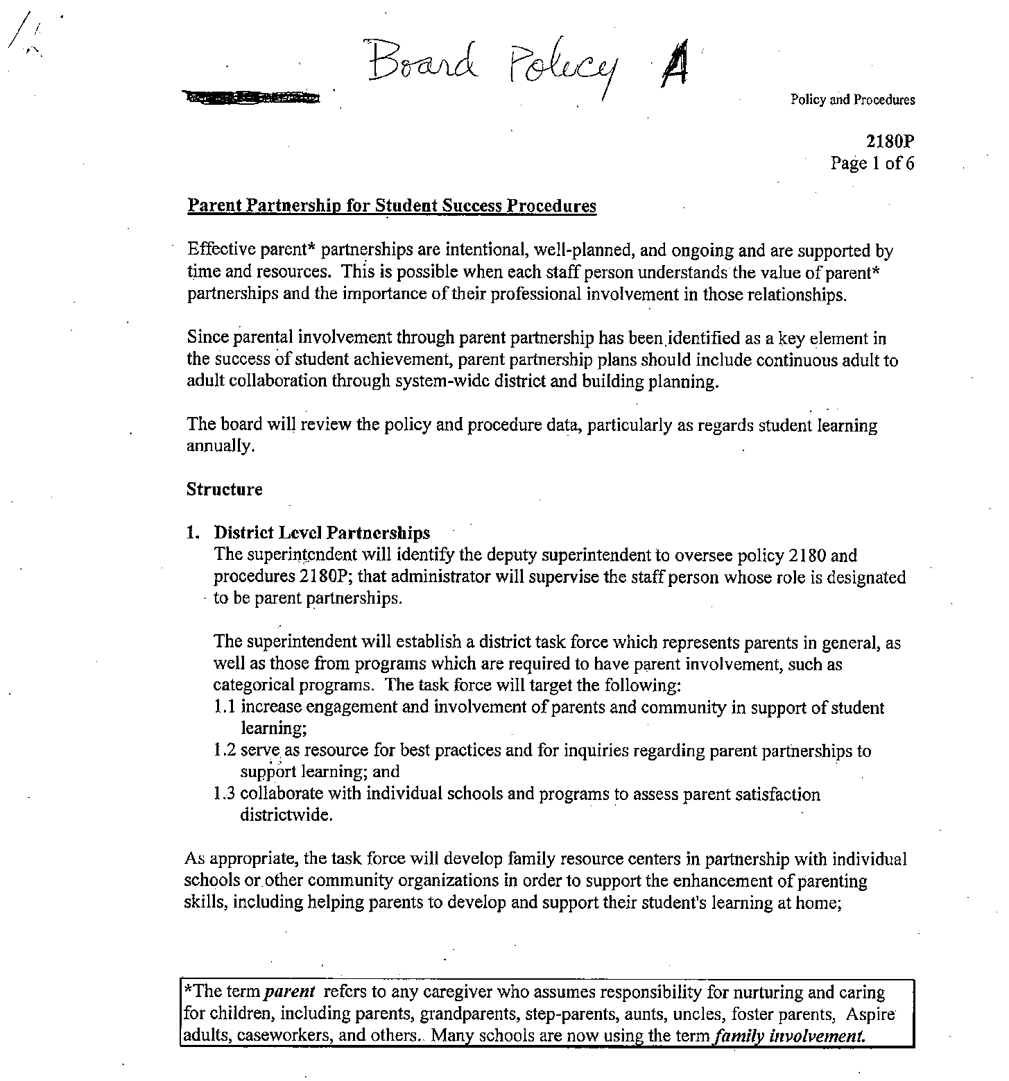

Slide 23
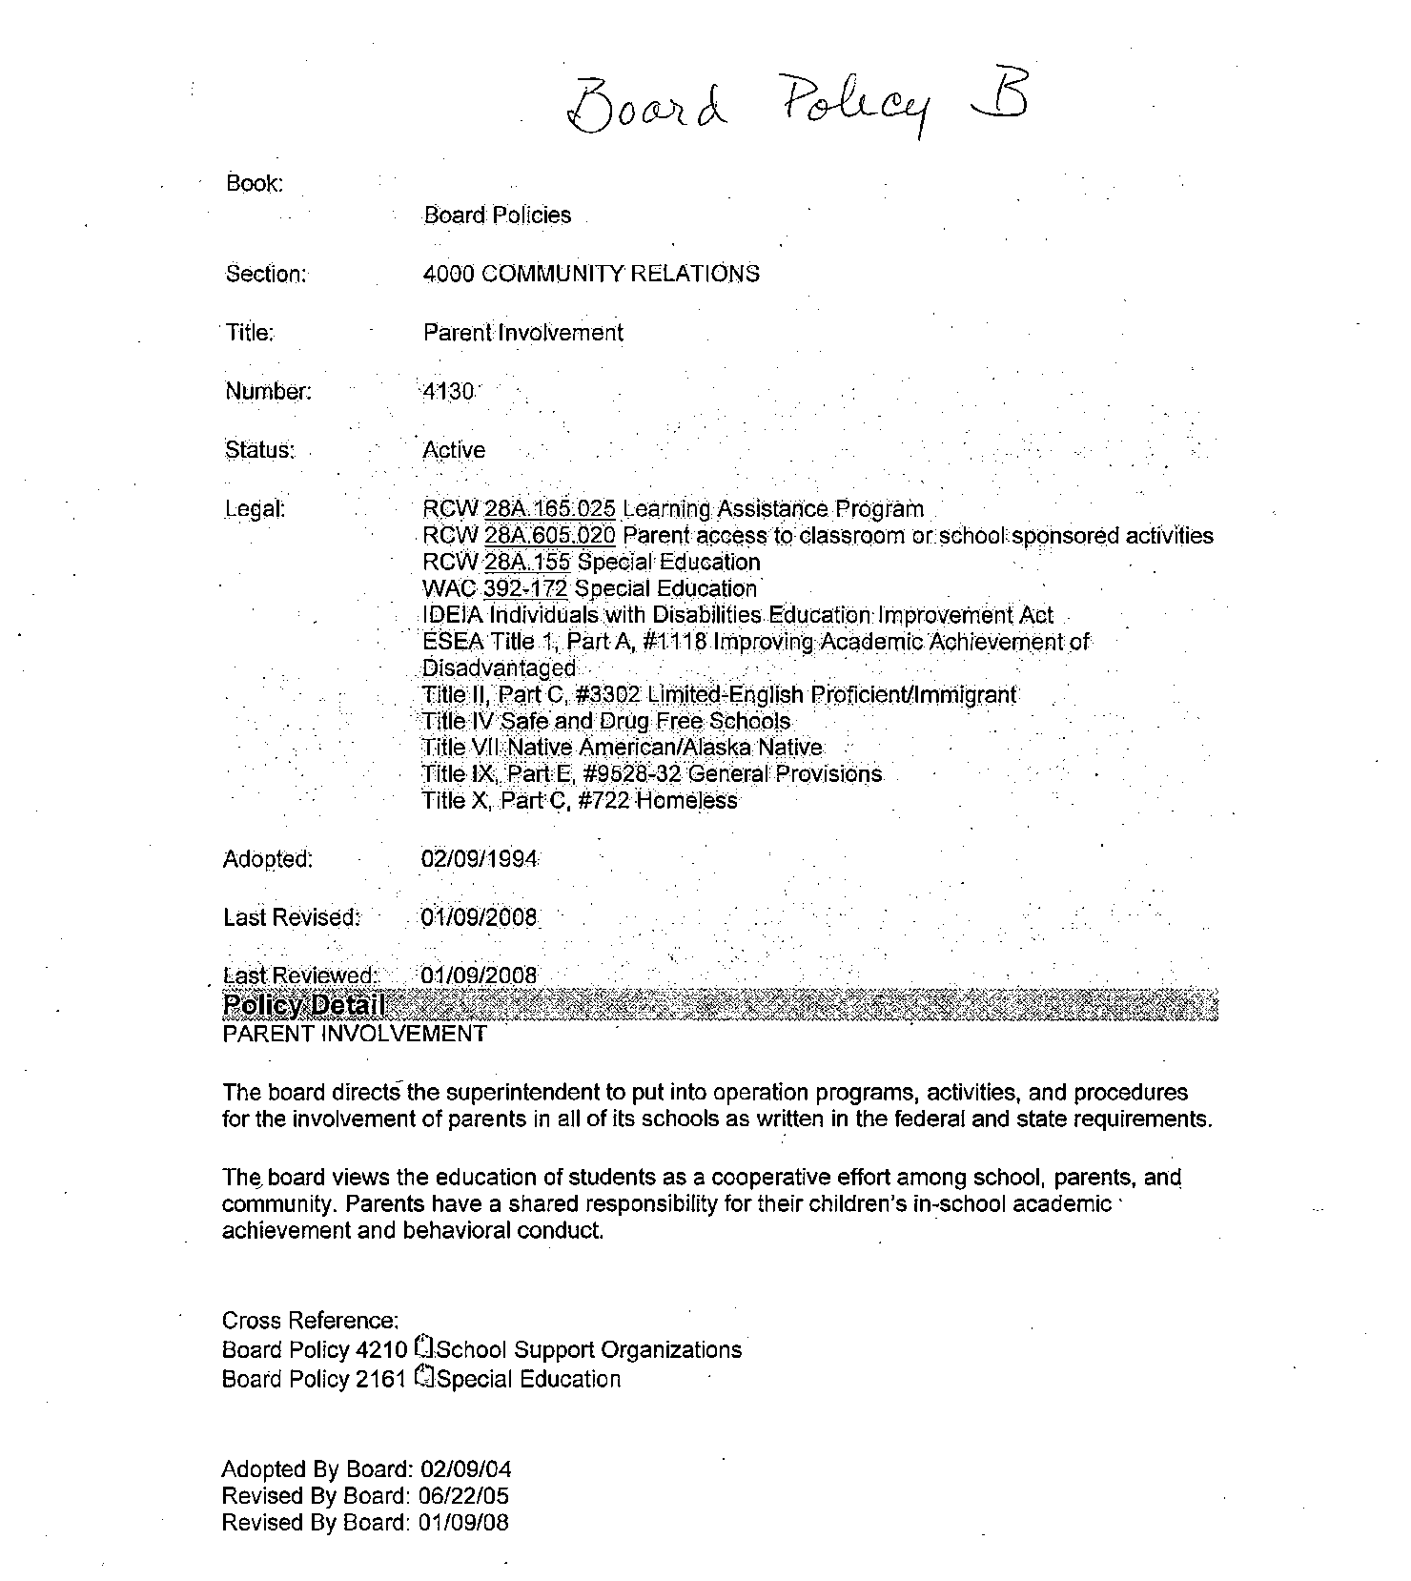

Slide 24
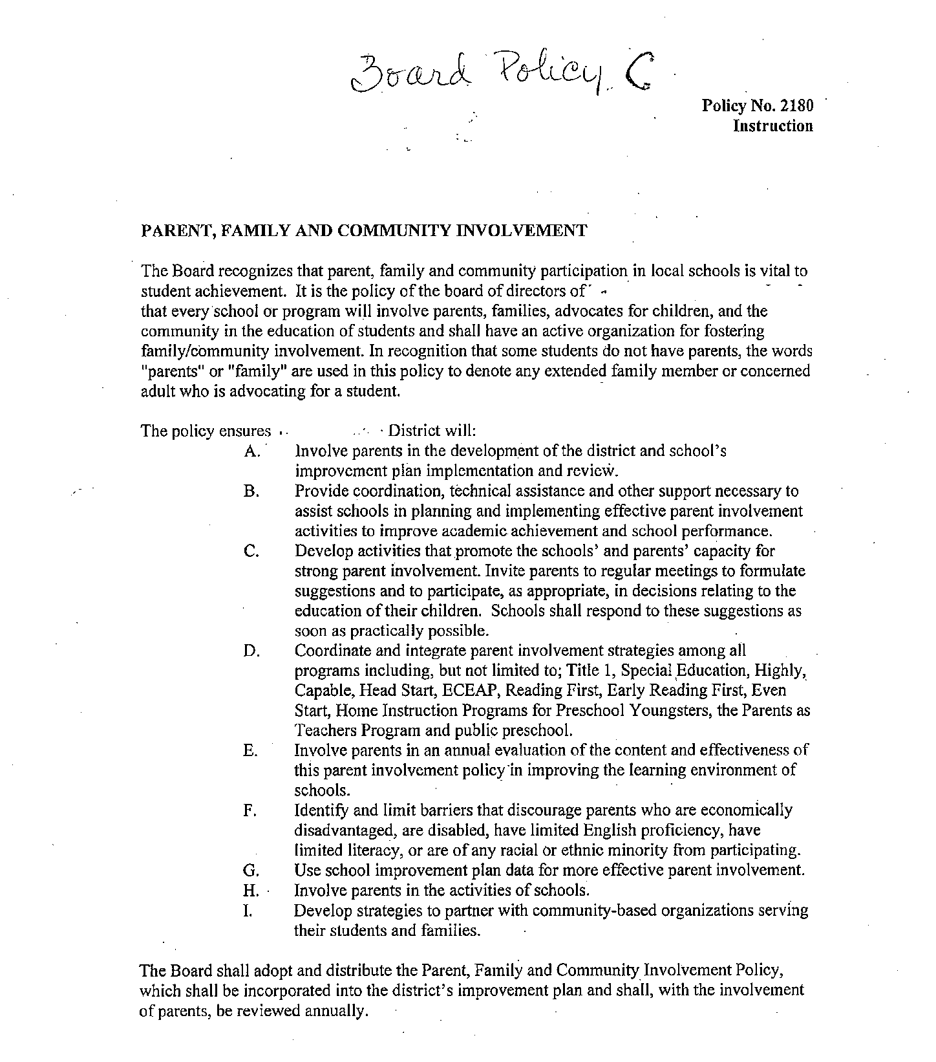

Slide 25
OEO Materials
Parent Manuals
The Dictionary of Educational Terms
Brochures
www.waparentslearn.org
The Office of the Education Ombudsman
155 NE 100th St - 210
Seattle, WA 98125
1-866-297-2597

